Slide 1
Presence

Slide 2
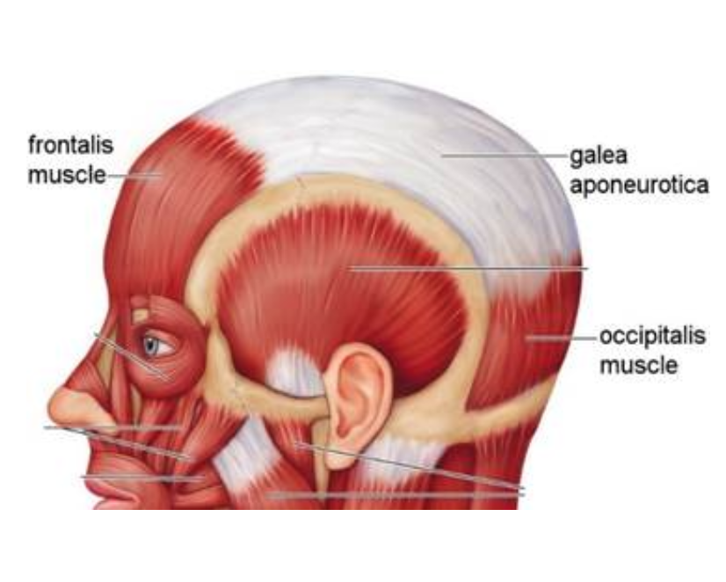
AU1 "Inner Brow Raiser"
AU1 uses the inner portion of the Frontalis muscle to raise the inner brow. The Frontalis runs vertically from the top of the head to the eyebrows and covers virtually the entire forehead. Note that the inner portion of this muscle (AU1) can act separately from the outer portion of this muscle (AU2).
Shape & Appearance
Pulls the inner portion of the eyebrows upwards.
Causes the skin in the center of the forehead to wrinkle horizontally. If there are already wrinkles present they will deepen. Wrinkles may be curved rather than horizontal.
Produces an oblique or / \ shape to the eyebrows. May pull the outer corner of the brow inwards but not upwards (AU2).
Primary Features to Look For
1. Marked inner brow raise
OR
2. Slight wrinkles or bulge above the inner brow
OR
3. Slight wrinkles in forehead center

Slide 3
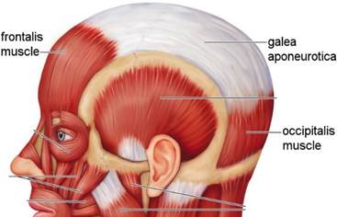
AU2 "Outer Brow Raiser"
AU2 uses the outer portion of the Frontalis muscle to raise the outer brow. The Frontalis runs vertically from the top of the head to the eyebrows and covers virtually the entire forehead. Note that the inner portion of this muscle (AU1) can act separately from the outer portion of this muscle (AU2).
Shape & Appearance
Pulls the lateral (outer) portion of the eyebrows upwards.
Produces an arched shape to the eyebrows.
Causes the lateral portion of the eye cover fold to be stretched upwards.
May cause short horizontal wrinkles to appear above the outer portions of the eyebrows.
May move the inner corners of the brows slightly.
Primary Features to Look For
outer brow pulled up slightly (changing the shape of the brow) AND eye cover fold stretched slightly
slight horizontal wrinkles above the outer brow.
pulling up of the outer brow (changing the shape of the brow)
stretching of the eye cover fold
wrinkles above the outer brow

Slide 4
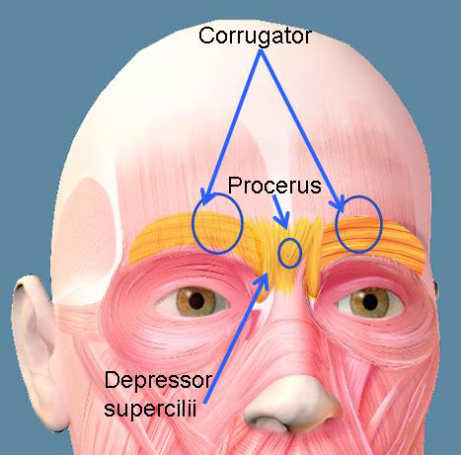
AU4 "Brow Lowerer"
AU4 uses three different muscles, the Procerus, the Corrugator Supercilii, and the Depressor Supercilli. Note that in adults these muscles rarely move independently, however in infants the movements of the Corrugator Supercilii and the Procerus are separated into AU3 and AU4 respectively.
Shape & Appearance
Lowers the eyebrows.
Pulls the eyebrows closer together.
Produces vertical or angled wrinkles between the eyebrows. May also produce one or more horizontal wrinkles at the root of the nose.
May produce a muscle bulge above and/or between the inner brows.
Pushes the eye cover fold downwards and may narrow the eye aperture.
Primary Features to Look For
1. Inner brows are pulled down and pulled together slightly (producing wrinkles or a bulge between the brows)
OR
2. Marked wrinkling and marked bulging between the brows
OR
3. Downwards eye cover fold, with narrowed eye aperture

Slide 5
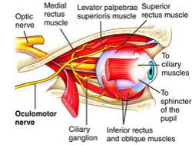
AU5 "Upper Lid Raiser"
AU5 uses two different muscles, the Levator Palpebrae Superioris and the Superior Tarsal Muscle. These muscles are located behind and within the upper eyelid respectively.
Shape & Appearance
Widens the eye aperture.
Raises the upper eyelid so that some or all of the upper eyelid disappears from view.
More of the upper portion of the eyeball (sclera above the iris) is exposed.
The lower eyelid also raises, very minutely, when there is a strong AU5.
Note
AU5 can happen simultaneously with eyes squeezing.
Primary Features to Look For
Widened eye aperture
Some upper eyelid disappears
More upper eyeball is exposed

Slide 6
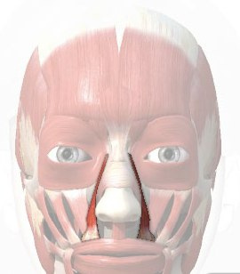
AU9 "Nose Wrinkle"
AU9 uses the Levator Labii Superioris Alaeque Nasi muscle (highlighted in the image to the right) which stretches between the root of the nose and bottom of the nostrils.
Shape & Appearance
Pulls the skin along the sides of the nose upwards towards the root of the nose causing wrinkles to appear along the sides of the nose and across the root of the nose.
Pulls the infraorbital triangle upwards, causing the infraorbital furrow to wrinkle (or, if it is permanently etched, to deepen), and bunching or bagging of the skin around the lower eyelid.
Lowers the inner portion of the eyebrows.
Pulls the center of the upper lid upwards. If the action is strong, the lips part, otherwise the lips may remain closed.
May widen and raise the nostril wings.
May deepen the nasolabial furrow if the action is strong.
Primary Features to Look For
skin on the side of the nose sharply pulled towards the bridge (center) of the nose
wrinkles on the side or bridge of the nose (as opposed to a crease)

Slide 7
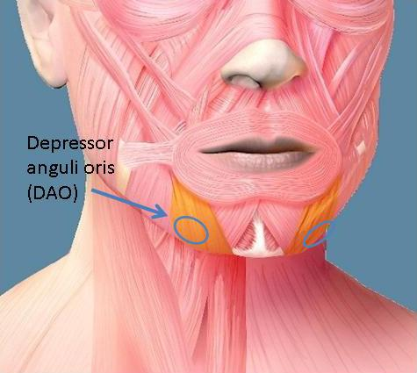
AU15 "Lip Corner Depressor"
AU15 uses the Depressor Anguli Oris also known as the Triangularis. This muscle extends up from the jawbone into the lip corners. It is the primary muscle used in frowning.
Shape & Appearance
Pulls the corners of the lips down.
Changes the shape of the lips so they are angled down at the corner, and usually the lower lip is somewhat stretched horizontally.
Produces some pouching, bagging, or wrinkling of the skin below the lip corners, which may not be apparent unless the action is strong.
May flatten or cause bulges to appear on the chin boss, may produce a depression medially under the lower lip.
If the nasolabial furrow is permanently etched, it deepens in the lower portion and may appear pulled down or lengthened.
Primary Features to Look For
lip corners move slightly down
Inverted-U mouth shape
Possible wrinkles below the lip corners

Slide 8
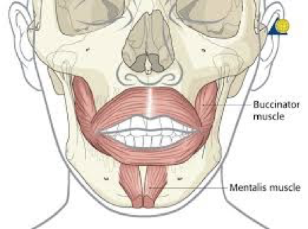
AU17 "Chin Raiser"
AU17 uses the Metalis muscle, which extends from the tip of the chin into the lower lip and contracts upwards and inwards to raise the chin.
AU17 Shape & Appearance
Pushes the chin boss upward
Pushes the lower lip upward
May cause wrinkles to appear on the chin boss as skin is stretched, and may produce a depression medially under the lower lip.
Causes shape of mouth to appear as an inverted-U shape or for this shape to increase if present in neutral.
If the action is strong enough, the lower lip may protrude. In some people, protrusion can occur even in weak actions, especially if lips are moist and there is no friction holding lip against lip.
Primary Features to Look For
1. Pushing up of the lower lip with inverted U-mouth shape ​
OR
2. Slight wrinkling or dimples in the chin boss
OR
3. Lower lip protruding or sliding outwards

Slide 9
Onset

